Slide 1
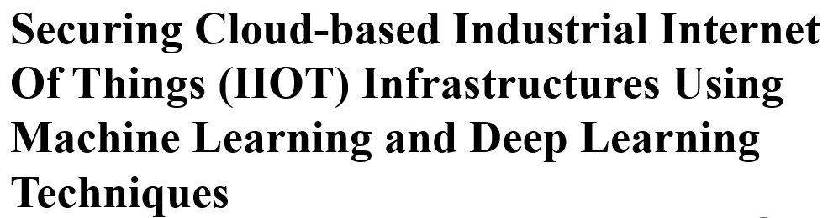



Vivien Sunnyval (230177219)
Presentation by
Vivien Sunnyval (230177219)
COMPUTER SCIENCE
DEPARTMENT :

Slide 2

Vivien Sunnyval (230177219)
INTRODUCTION
The integration of IoT in various domains, including industrial systems, has led to the development of the Industrial Internet of Things (IIoT) (Graber et al., 2023).
IIoT enhances company reliability and efficiency through machine learning, big data, and machine interaction (Aggarwal et al., 2021).
IIoT impacts manufacturing, healthcare, transportation, and agriculture by enabling better infrastructure monitoring and data access (Veloso et al., 2022).
IIoT improves operational efficiency and productivity but requires robust security and privacy measures to prevent cybercrimes like Distributed denial of service (DDoS) attacks and MitM attacks (Sharma et al., 2020).
AI and ML techniques are crucial for addressing security and privacy challenges in IIoT.
Page
2

Slide 3

BACKGROUND AND PURPOSE
AI and ML techniques are used to develop intrusion detection systems (IDS) for cloud-based IIOT infrastructures (Veloso et al., 2022).
However, current approaches often rely on actual datasets without utilizing feature selection.
Additionally, prior detection algorithms have not adequately addressed imbalanced datasets.
In addition, it is essential to explore the performance of DL and ML techniques of different IIOT dataset such as NSL-KDD and WUSTL-IIot dataset.
PURPOSE
The aim of this study is to implement deep learning and machine learning techniques including GRU, Random Forest (RF), k-nearest Neighbours (KNN), and Long Short-Term Memory (LSTM) for securing cloud-based industrial internet of things (IIOT) infrastructures.
The specific objectives is to use SMOTE for class balancing and Particle Swarm Optimisation (PSO) for feature selection
Vivien Sunnyval (230177219)
3

Slide 4

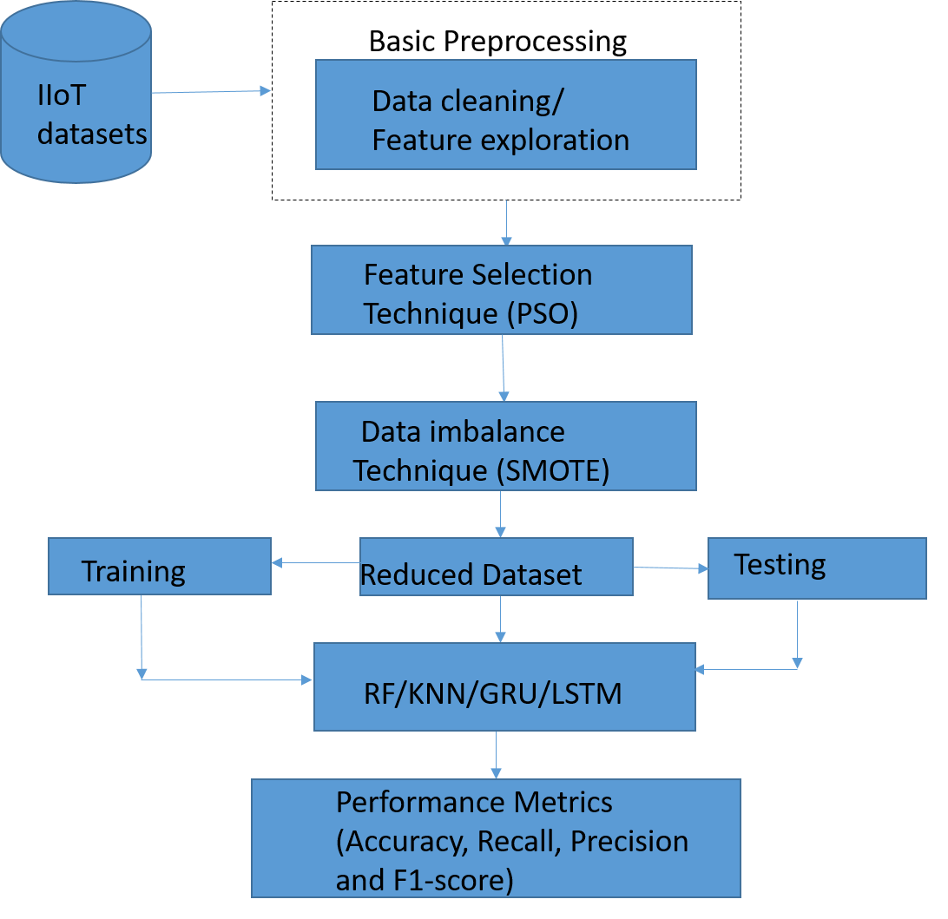
METHODOLOGY
Vivien Sunnyval (230177219)
The prediction model used datasets from Kaggle and GitHub, with data preparation steps including feature selection, cleaning, and balancing.
Four classification methods (LSTM, Random Forest, GRU, KNN) were tested, and performance was measured using accuracy, precision, recall, and F1-score.
6

Slide 5
FINDINGS/RESULT
The Random Forest model achieved perfect scores (100%) in accuracy, precision, recall, and F1-Score on the WUSTL-IIoT dataset, outperforming other models such as KNN, LSTM, and GRU.
The Random Forest model, using particle swarm optimization and SMOTE, was found to be the most effective for detecting security threats in the dataset, with minimal risk of overfitting.
Vivien Sunnyval (230177219)
Detection Model | Performance Metrics
 | NSL-KDD dataset |  |  |  | WUSTL-IIot dataset
 | Accuracy | Recall | Precision | F1-Score | Accuracy | Recall | Precision | F1-Score
Random Forest | 91.00% | 91.00% | 91.00% | 91.00% | 100.00% | 100.00% | 100.00% | 100.00%
K-Nearest Neighbor | 90.50% | 91.00% | 91.00% | 91.00% | 100.00% | 99.00% | 99.00% | 100.00%
LSTM | 90.62% | 91.00% | 91.00% | 91.00% | 98.94% | 99.00% | 99.00% | 99.00%
GRU Network | 90.65% | 91.00% | 91.00% | 91.00% | 98.92% | 99.00% | 99.00% | 99.00%
8

Slide 6
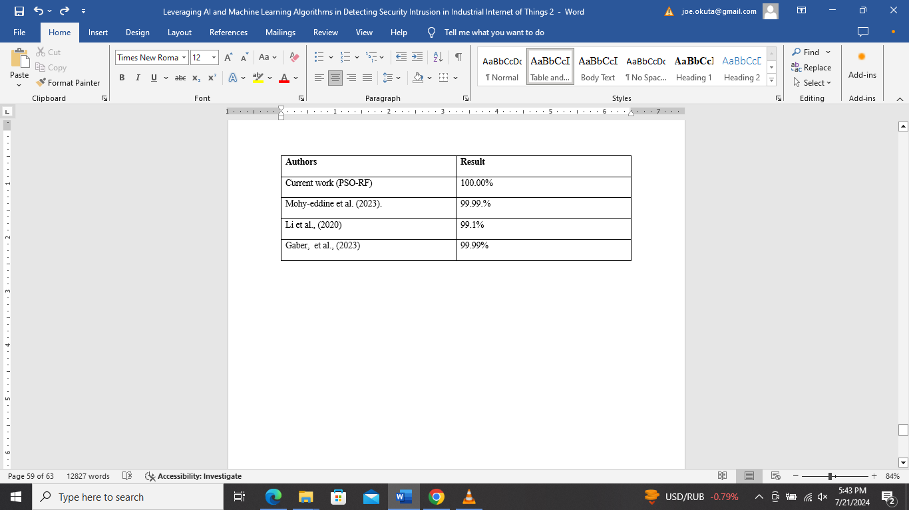
DISCUSION/RESULT COMPARISON
The result was compared with other prior study in the literature.
The Random Forest model, using particle swarm optimization and SMOTE, was found to be the most effective for detecting security threats in the dataset, with minimal risk of overfitting.
Vivien Sunnyval (230177219)
8

Slide 7

Vivien Sunnyval (230177219)
CONCLUSION AND FUTURE WORK SUGGESTION
In conclusion, this study build an IDS using ML and DL, with PSO for feature selection and SMOTE for data imbalance.
Algorithms like LSTM, GRU, random forest, and KNN were tested on NSL-KDD and WUSTL-IIoT datasets.
FUTURE WORK SUGGESTION
It is recommended that future studies investigate how to apply an ensemble learning model comprising Artificial Neural Networks (ANNs), logistic regression, and Support Vector Machines (SVMs).
Page
9

Slide 8
References
Aggarwal, R., Bansal, S. and Kumar, P. (2021) Enhancing company reliability and efficiency through IIoT and machine learning. International Journal of Advanced Research in Computer Science, 12(4), pp.45-58.
Graber, D., Smith, J. and Lopez, M. (2023) The Industrial Internet of Things: A comprehensive overview. Journal of Industrial Technology, 29(2), pp.113-127.
Sharma, V., Patel, R. and Singh, A. (2020) Addressing security and privacy in IIoT: Challenges and solutions. Cybersecurity Journal, 8(3), pp.78-92.
Veloso, F., Almeida, L. and Nunes, P. (2022) Impact of IIoT on various domains: A detailed analysis. Journal of Emerging Technologies, 15(1), pp.203-220.
Vivien Sunnyval (230177219)
6

